Slide 1
Blocking

Slide 2

About the Author
Created By:
Credential Information:
Version and Date: | SS2008/0611/1.0
Cognizant Certified Official Curriculum

Slide 3









Icons Used
Hands on Exercise
Questions
Tools
Coding Standards
Test Your Understanding
Reference
A Welcome Break
Contacts
Demonstration

Slide 4
Blocking: Overview
At the end of this presentation you’ll come to know:
  What is blocking?
  What are its cause?
  Identifying blocking
  Avoidance
  Scenarios and Resolutions

Slide 5
Blocking: Objective
Objective:
After completing this chapter you will be able to:
  How different objects block each other
  Effective ways of avoiding it

Slide 6
What is blocking?
SQL Server blocking occurs when one connection (user process or application process) places a lock on a table (or a number of rows) and a second connection attempts to read or modify the data under the lock.
The term "connection" refers to a single logged-on session of the database

Slide 7
Blocking: Causes
SPID lock holding onto a set of resources for an extended period of time (Long running queries)
SPID lock never releasing the resources
Cancelling queries
Client server deadlock

Slide 8
How to identify blocking?
Identify the SPID (Session ID) at the head of the blocking chain and the SQL Statement.
- DBCC INPUTBUFFER(<spid>)
Find the transaction nesting level and process status of the blocking SPID.
  - @@TRANCOUNT
  SELECT open_tran FROM master.sys.sysprocesses WHERE SPID=<blocking SPID number>

Slide 9
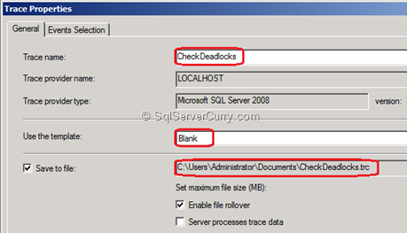
Trace Profiler

Slide 10
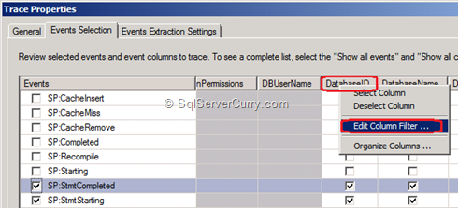
Trace Profiler: Event Selection

Slide 11
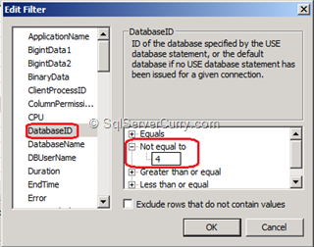
Trace Profiler: Parameters

Slide 12
Avoidance of Blocking
Query timeout
Lock timeout
  - SET LOCK_TIMEOUT timeout_period
Bounded connection
Checking upon the number of open transactions
  - DBCC opentran

Slide 13
Common Blocking Scenarios and Resolutions
1) Blocking Caused by a Normally Running Query with a Long Execution Time
Resolution:
- to look for ways to optimize the query.

Slide 14
Common Blocking Scenarios and Resolutions
  2) Blocking Caused by an Orphaned Connection
  Resolution:
  If the client application has disconnected without appropriately cleaning up its resources, you can terminate the SPID(connection) by using the KILL command.
    Ex: KILL 9 [where 9 is the SPID]

Slide 15
Common Blocking Scenarios and Resolutions
3) Blocking Caused by a SPID Whose Corresponding Client Application Did Not Fetch All Result Rows to Completion
Resolution:
The application must be re-written to fetch all rows of the result to completion.

Slide 16
Common Blocking Scenarios and Resolutions
4) Blocking Caused by a Distributed Client/Server Deadlock
Resolutions:
  Query Timeout
  Bound Connections

Slide 17
Common Blocking Scenarios and Resolutions
5) Blocking Caused by a Sleeping SPID That Has Lost Track of the Transaction Nesting Level
Resolutions:
This can occur if the application experiences a query timeout, or issues a cancel without also issuing the required number of ROLLBACK and/or COMMIT statements.

Slide 18
Blocking: Test your Understanding
What is blocking?
What are its causes and ways to identify it?
Code and demonstrate a practical scenario where blocking would occur.

Slide 19
Blocking: Summary
Blocking happens when one connection from an application holds a lock and a second connection requires a conflicting lock type.
Resolutions to overcome blocking scenarios

Slide 20
Blocking: Sources
http://www.sql-server-performance.com/2006/blocking/
http://support.microsoft.com/kb/224453
http://msdn.microsoft.com/en-us/library/aa178087(v=SQL.80).aspx

Slide 21

You have successfully completed
SQL Server - Blocking Concepts

